Slide 1

Metadata II: Evaluating and Selecting Metadata Schemas

Slide 2
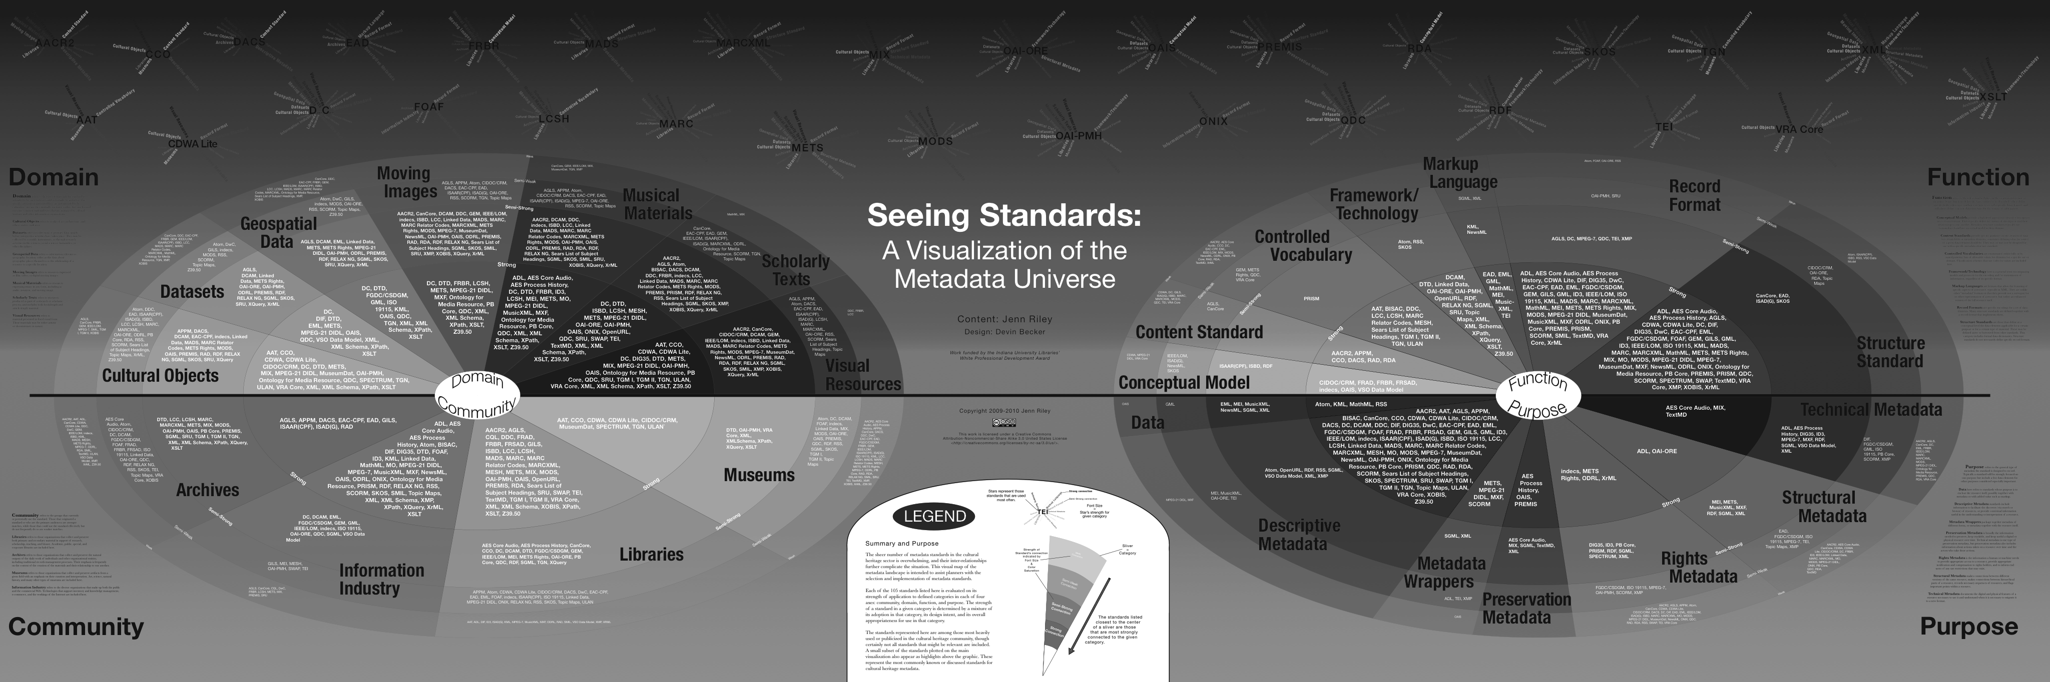
“The great thing about standards is that there’s so many of them”

Slide 3

And yet…

Slide 4
Why the proliferation?
No one-size-fits all standard
Local and community needs are heterogeneous and changing
Research data are hugely diverse!
Domain-specific needs are diverse!

Slide 5
Metadata for research data
Descriptive: must describe variables and data properties
Structural: formatted according to domain-/project-specific methods and standards
Administrative: rights, embargos, sharing
Notes:
Want to take a few minutes to talk about the particular metadata needs of research data. As nic reviewed…

Slide 6
Metadata for research data
Methods: reproducible research data requires well documented analytical and data collection methods!
Growing area of study
Controlled vocabularies and PROV-O can help

Slide 7
How to evaluate and select from such a diverse range?

Slide 8
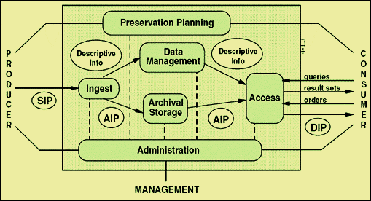
Producer vs. Manager vs. Consumer needs
Notes:
This can seem like a lot – so let’s reframe this according to one of the lifecycle models we looked at yesterday
Another way to divide types of metadata is by the groups of users it aims to serve

Slide 9
Manager (e.g. your) Needs
Before looking at schemas, articulate the “specificities” of your repository
What are your institution’s needs? What are the practical constraints of your work?

Slide 10
“Nine questions” for needs assessment
From Kennedy, 2008:
Who will be using the collection?
Who is the collection cataloguer?
How much time/money do you have?
How will your collection be accessed?
Notes:
Before we start looking at and comparing schemas its important to ask, “what’s the goal”
She’s not talking about data –
Still an emerging set of resources about data objects

Slide 11
Kennedy 2008 continued
How is your collection related to other collections?
What is the scope of your collection?
Will your metadata be harvested?
Do you want your collection to work with other collections?
How much maintenance or quality control do you wish?

Slide 12
Kennedy 2008 continued
How is your collection related to other collections?
What is the scope of your collection?
Will your metadata be harvested?
Do you want your collection to work with other collections?
How much maintenance or quality control do you wish?
Notes:
These questions point to the need to also evaluate consumer needs:

Slide 13
Consumer needs
Notes:
Also

Slide 14
Guiding questions: The MODAL framework
Developed by Jane Greenberg (Drexel)
Conceptual framework for analyzing Metadata Objectives and principles, Domain, and Architectural Layout
2005 paper establishes framework, Willis, Greenberg & White apply it to scientific data schemas in 2012
Notes:
Note that these categories are similar to descrptive, technical

Slide 15
MODAL applied
Guiding questions:
What is the scope of scientific metadata schemes?
What are the similarities and differences between scientific metadata schemes?
What are the fundamental requirements of metadata schemes for scientific data?

Slide 16
Different goals of scientific metadata
(Willis, Greenberg & White, 2012)

Slide 17

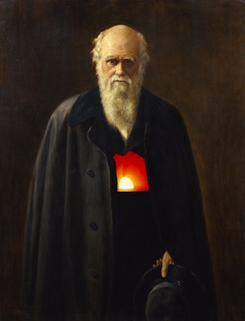

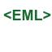

Domain Specific Standards
more
Notes:
For research data, more often than not, if this means trying to find a domain-specific standard

Slide 18
Domain Specific Standards
Pros: can better facilitate reuse by better describing data; greatly improves interoperability
Cons: hard to use and understand by non-expert; do not cover all use cases, even for their domain

Slide 19
There will always be many possible ways to do the same thing
100 a Shakespeare, William d 1564-1616
245 a Hamlet
260 a New York: b Penguin Books, c 2003
<dc:creator>Shakespeare, William, 1564-1616</>
<dc:title>Hamlet</>
<dc:publisher>Penguin Books</>
<dc:date>2003</>
Notes:
Note that these are equally flawed, too…

Slide 20
ICOADS dataset in 2 repositories
Notes:
Note that these are equally flawed, too…
Talk more about trade offs and affordances here
GCMD is broader, RDA is more specific (narrower Designated community)
Then show XML
Decision of what attrinbute value pair to use has a real consequence

Slide 21
Standards (and your ability to implement them) will always have limitations
Expressivity
Interoperability
Local needs
Community needs

Slide 23
Metadata III: Crosswalking, reconciliation and propagation

Slide 24
How would we aggregate these records?
100 a Shakespeare, William d 1564-1616
245 a The Tempest
260 a London: b Arden Shakespeare, c 1999
<dc:creator>Shakespeare, William, 1564-1616</>
<dc:title>Hamlet</>
<dc:publisher>Penguin Books</>
<dc:date>2003</>

Slide 25
Or move this one into a more general repository?
Notes:
Note that these are equally flawed, too…
Talk more about trade offs and affordances here
GCMD is broader, RDA is more specific (narrower Designated community)
Then show XML
Decision of what attrinbute value pair to use has a real consequence

Slide 27
GCMD Result
Notes:
Note that these are equally flawed, too…
Talk more about trade offs and affordances here
GCMD is broader, RDA is more specific (narrower Designated community)
Then show XML
Decision of what attrinbute value pair to use has a real consequence

Slide 28
GCMD Result
Notes:
Note that these are equally flawed, too…
Talk more about trade offs and affordances here
GCMD is broader, RDA is more specific (narrower Designated community)
Then show XML
Decision of what attrinbute value pair to use has a real consequence

Slide 29
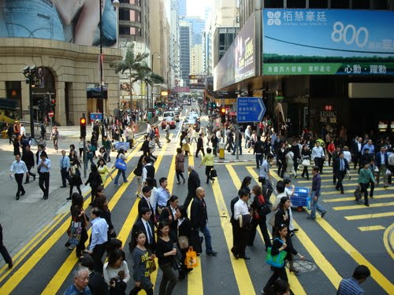
Crosswalking
Brings overlapping standards together
Necessary for aggregation and integration
Important but tricky
Notes:
As a result of the high amount of specificy for each repository and data center, when bringing records together, or publishing to more general repositories, there’s a need to translate, (or crosswalk) one standard into another.

Slide 30
A more familiar example
CDWA | MARC/AACR | MODS | Dublin Core
Catalog Level | 655 Genre/Form 300a Physical Description - Extent | <genre> <extent>
Object/Work Type | 655 Genre - Form | <genre> | Type
Components/Parts | 300a Physical Description - Extent | <extent> | Format.Extent
Classification Term | 050 084 "Other classification number" | <classification> | Subject (classification schema)
Title Text | 24Xa Title and Title - Related Information | <classification> | Subject (classification schema)

Slide 31
TWO MORE SLIDES – domain specific examples

Slide 32
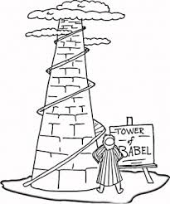
Crosswalking research data
“Push”: Darwin Core published through IPT
“Pull”: ICOADS in RDA harvested by GCMD

Slide 33
Crosswalking research data
Can be more complicated
Unit conversion
Idiosyncratic controlled vocabularies
Can be “lossy”

Slide 34
How does this:
Become this:
?

Slide 35
Data “friction”
“Every movement of data across an interface comes at some cost in time, energy, and human attention. Every interface between groups and organizations, as well as between machines, represents a point of resistance where data can be garbled, misinterpreted, or lost…
…data friction consumes energy and produces turbulence and heat – that is, conflicts, disagreements, and inexact, unruly processes”

Slide 36
Finding “friction” by examining completeness & coverage
Searched for “mola mola”
Evaluated every version of the “same” specimen record published/harvested through different services
KUBI local website
GBIF
VertNet

Slide 38
Losses:
Size/“lifestage”: larva
Difference: 1mm vs. 4 m!

Slide 40
Every point of transfer = point of potential data loss

Slide 41


